Slide 1
Trends in electricity production
vs.
Economic growth
Data Engineering 1
Naida Dzigal
December 10th 2022

Slide 2
Outline
Aim of project
How to approach using simple plotting in Knime
Knime pipeline
Plots 1990 vs. 2010
Trends in Nuclear
Trends in oil, gas and coal
GDP-PPP versus population size
Conclusions

Slide 3
Aim of project
To investigate if population growth is the main driver in a higher oil, gas and coal diet worldwide.

Slide 4
How?
Plot
Electricity production for nuclear, oil, gas and coal in year 2010
GDP-PPP versus population size in the year 2010
Compare to 1990 to provide context
Explain
Are there trends?
What conclusions can be drawn, if any?

Slide 5
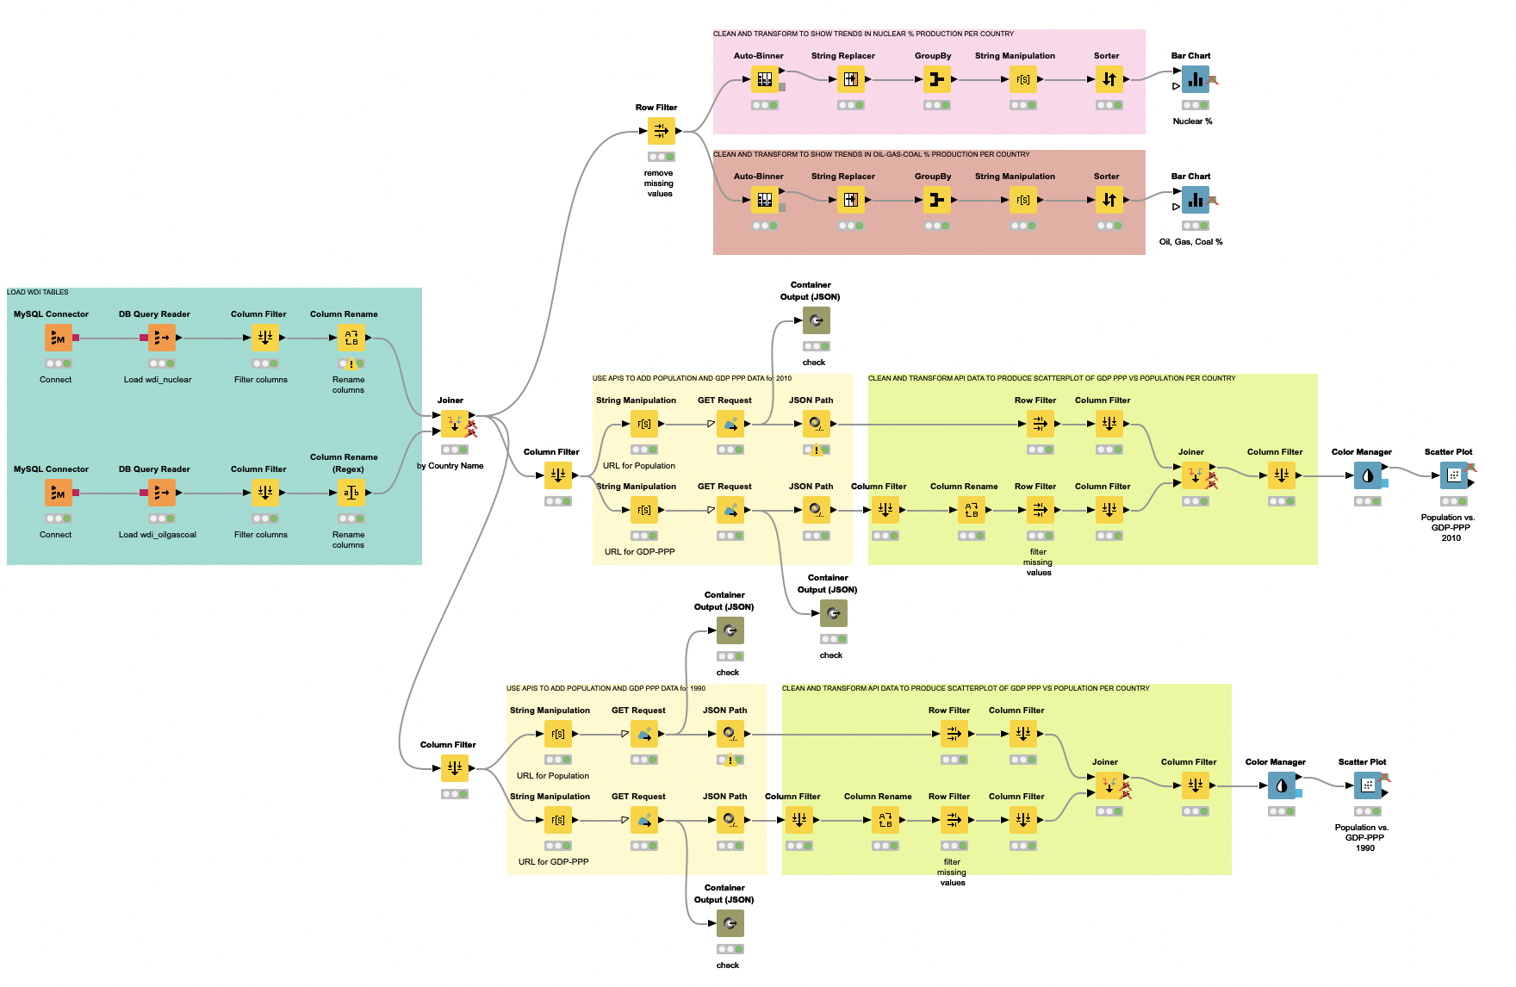
Knime pipeline

Slide 6
Barcharts
Load data
Scatterplots
Knime pipeline

Slide 7
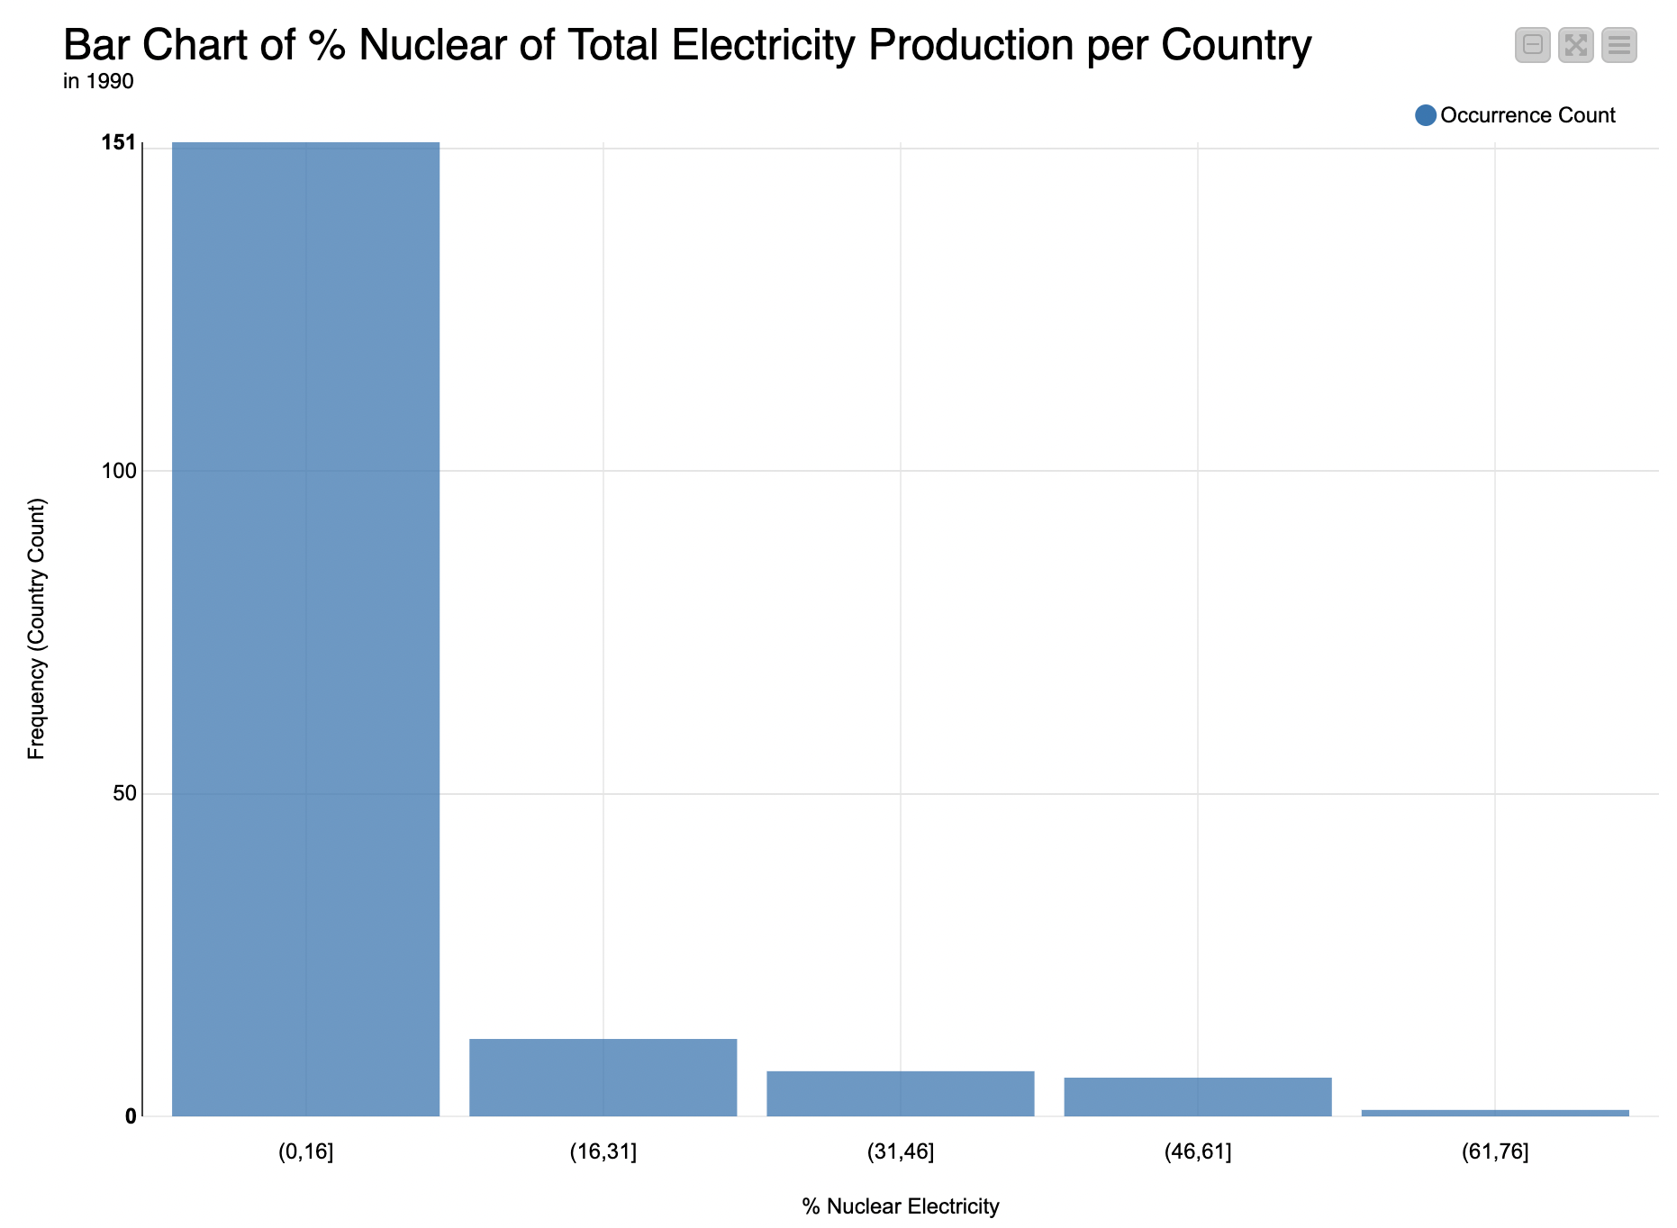
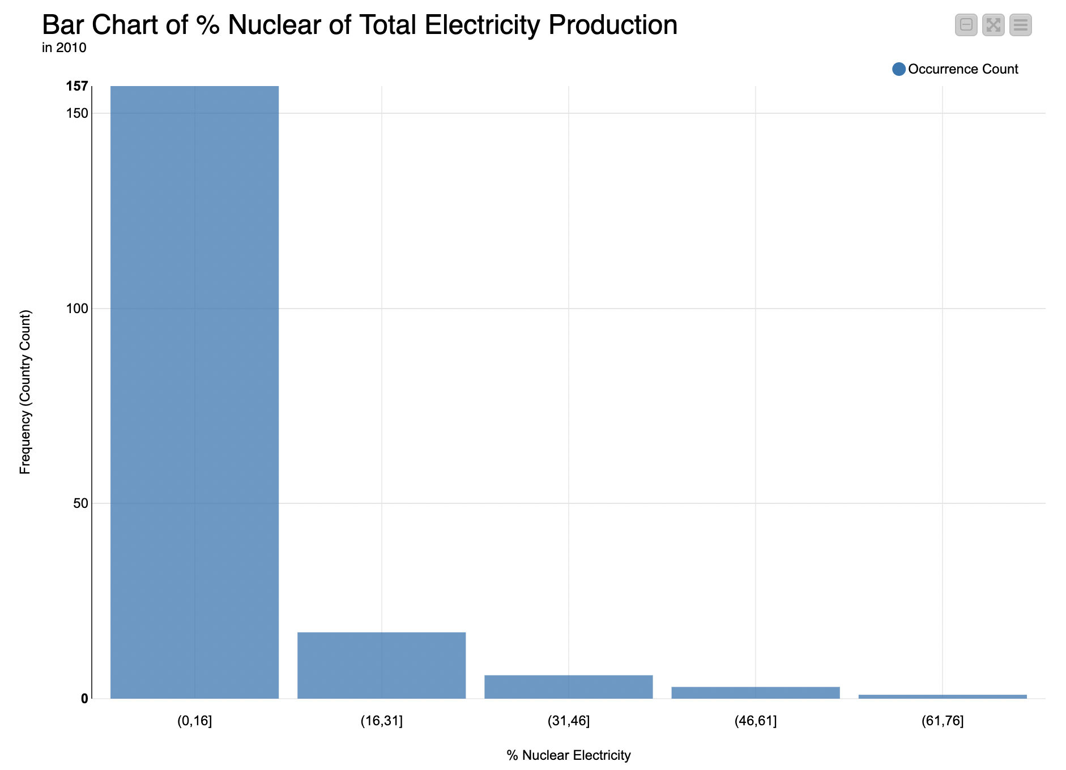
Trends in nuclear 1990-2010

Slide 8
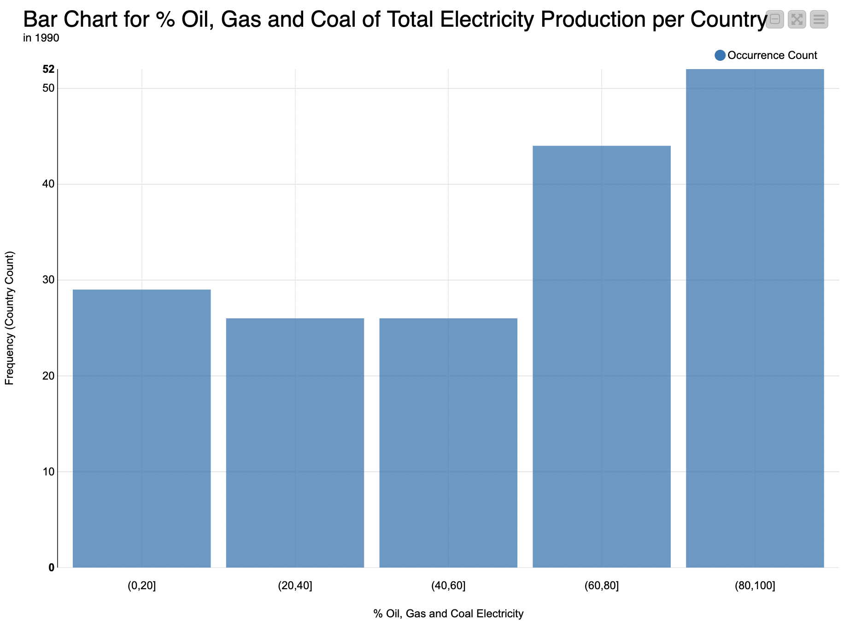
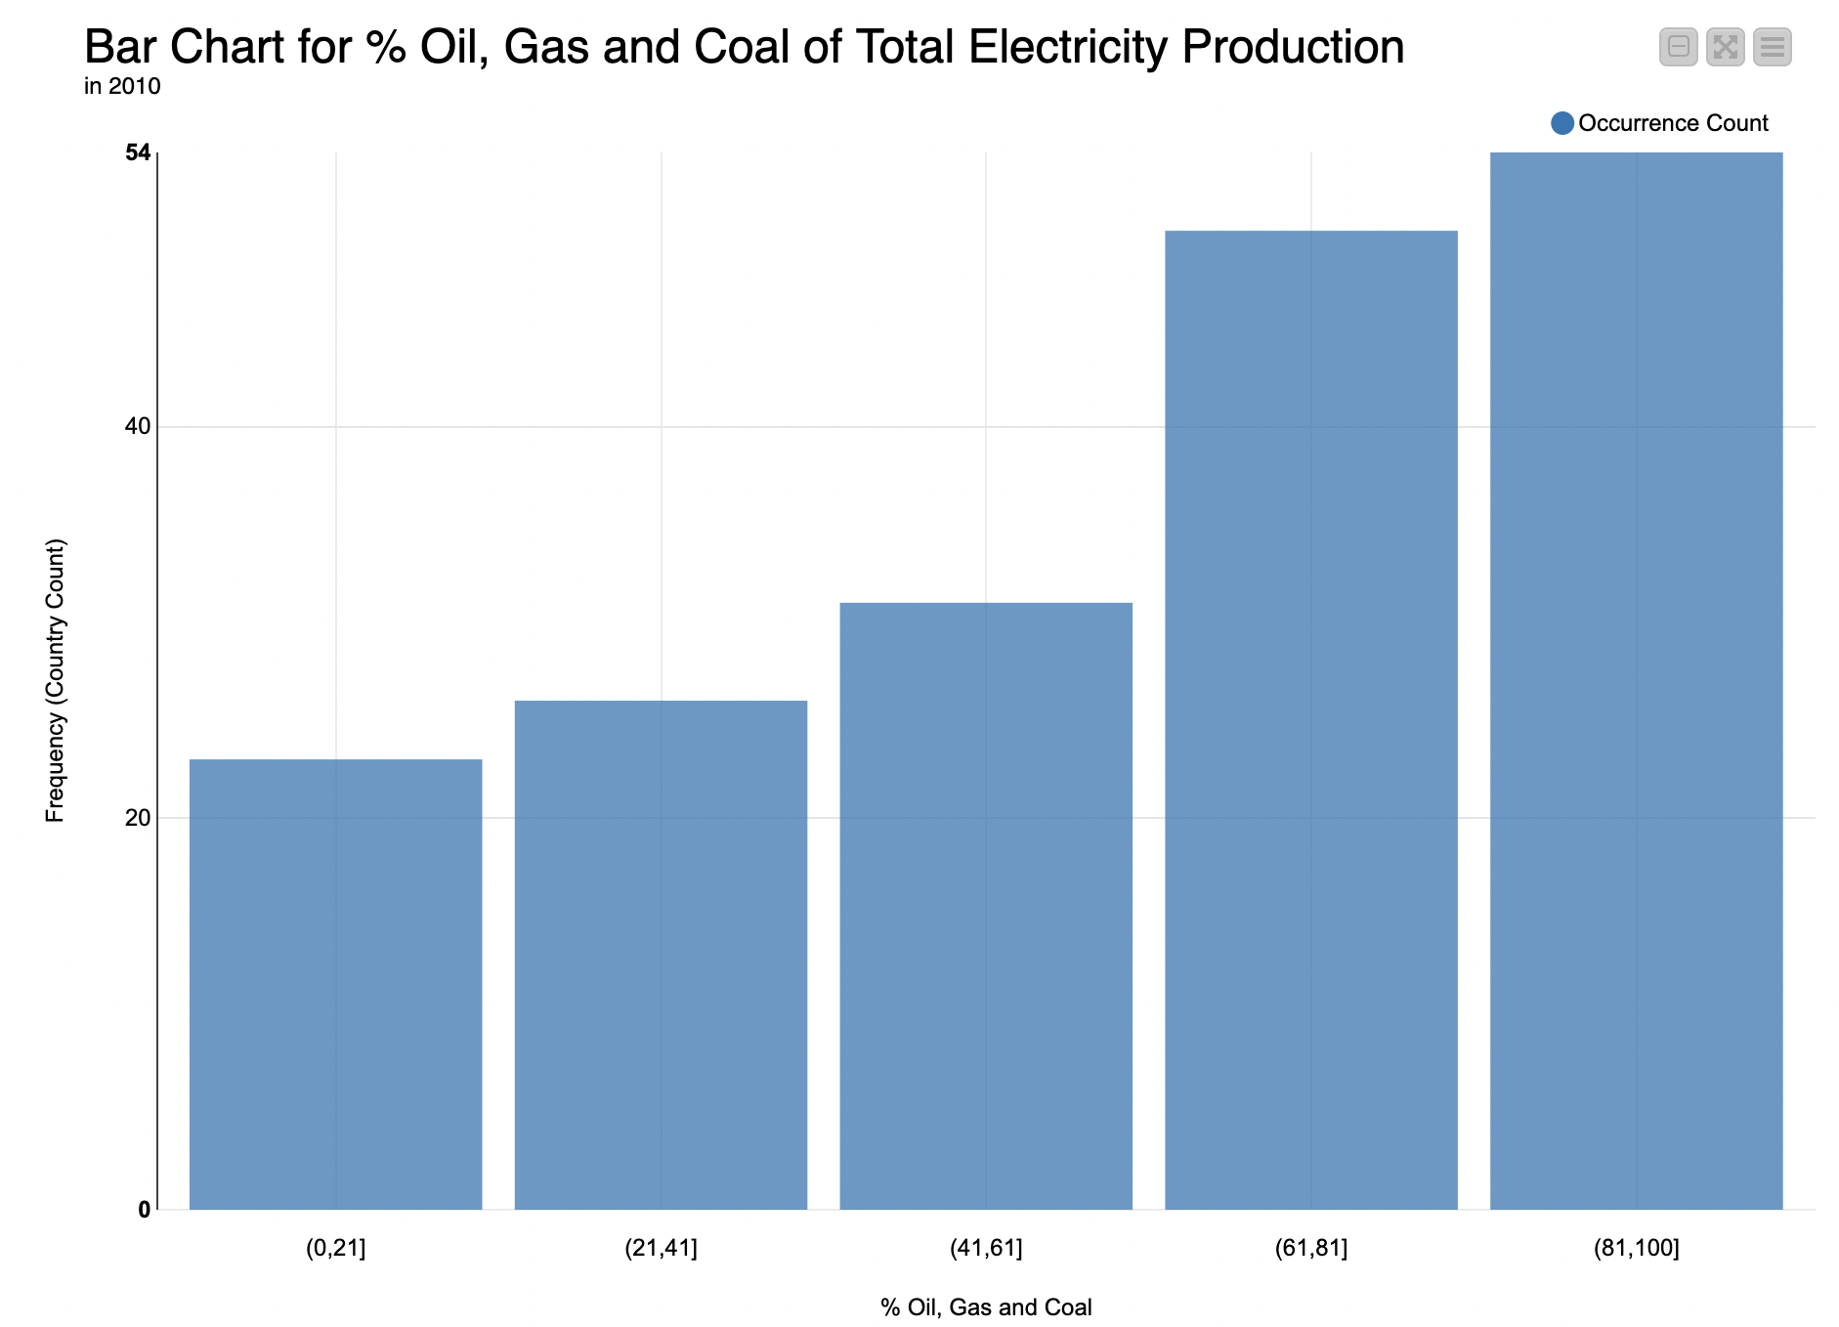
Trends in oil, gas and coal 1990-2010

Slide 9
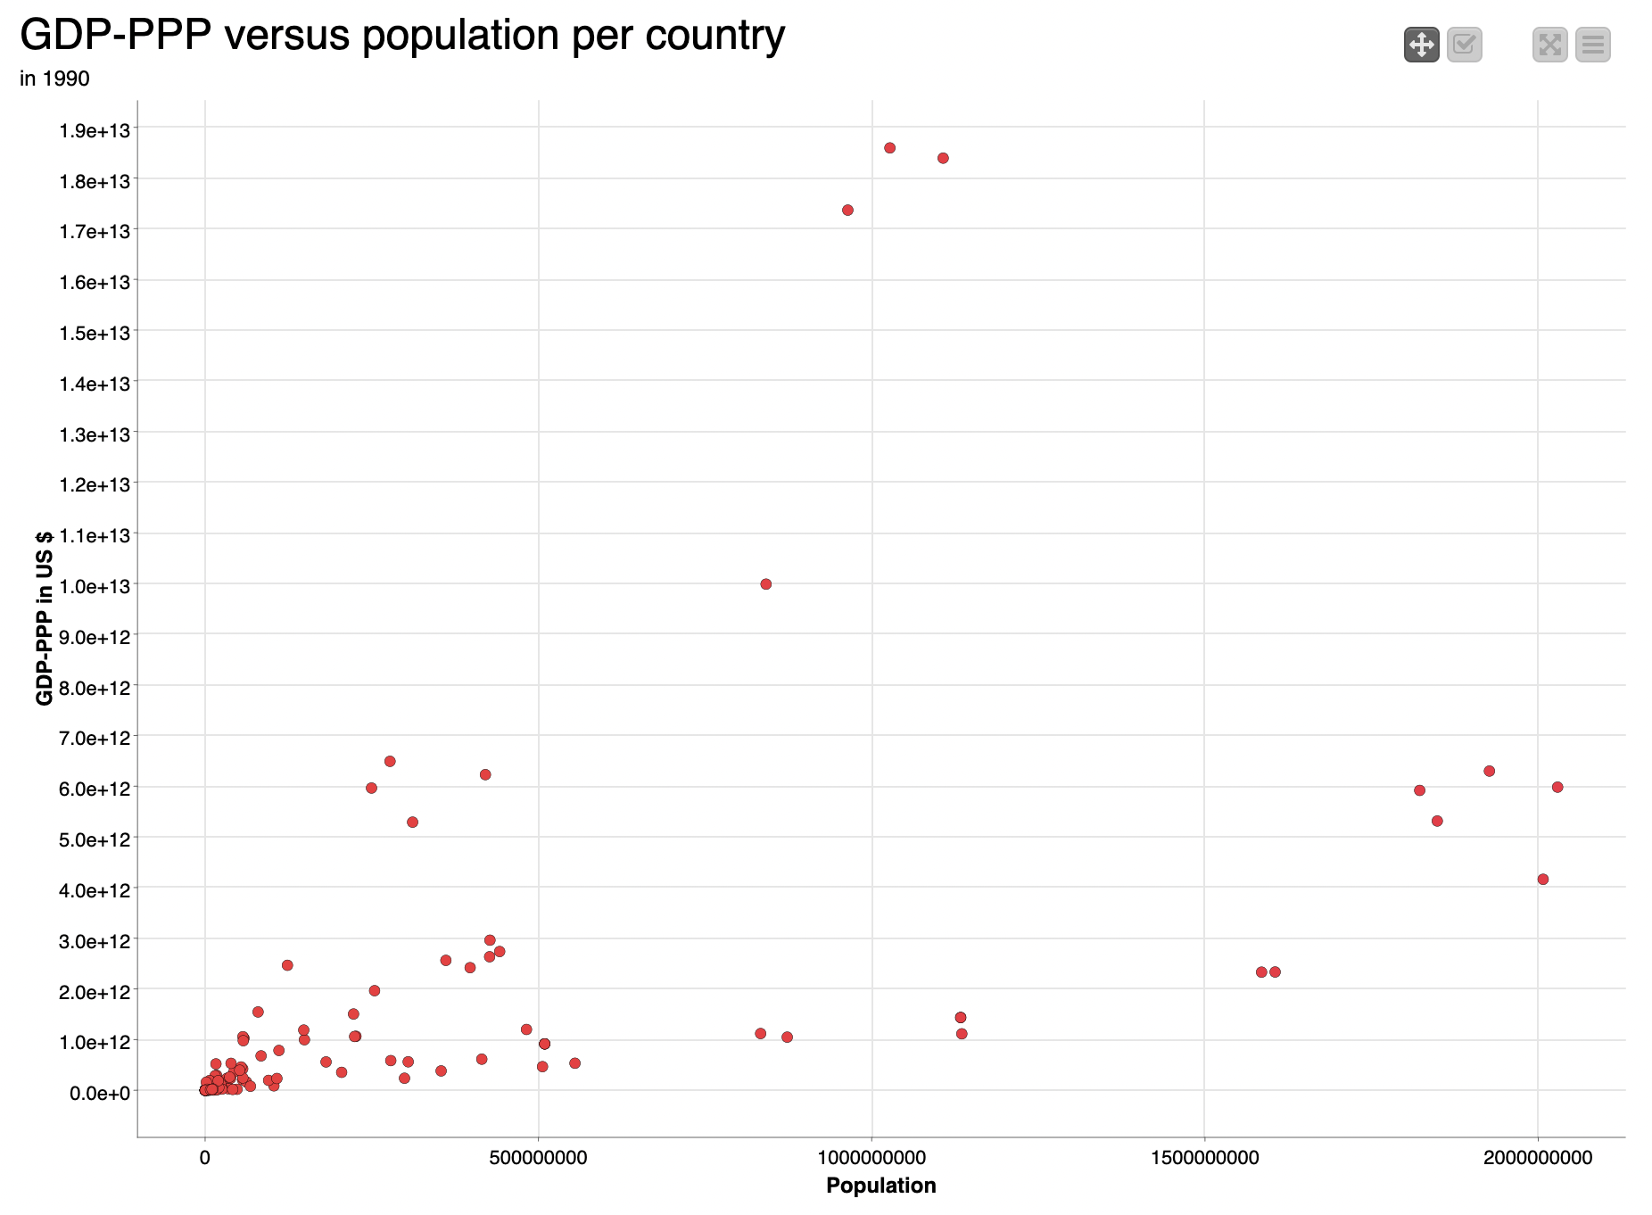
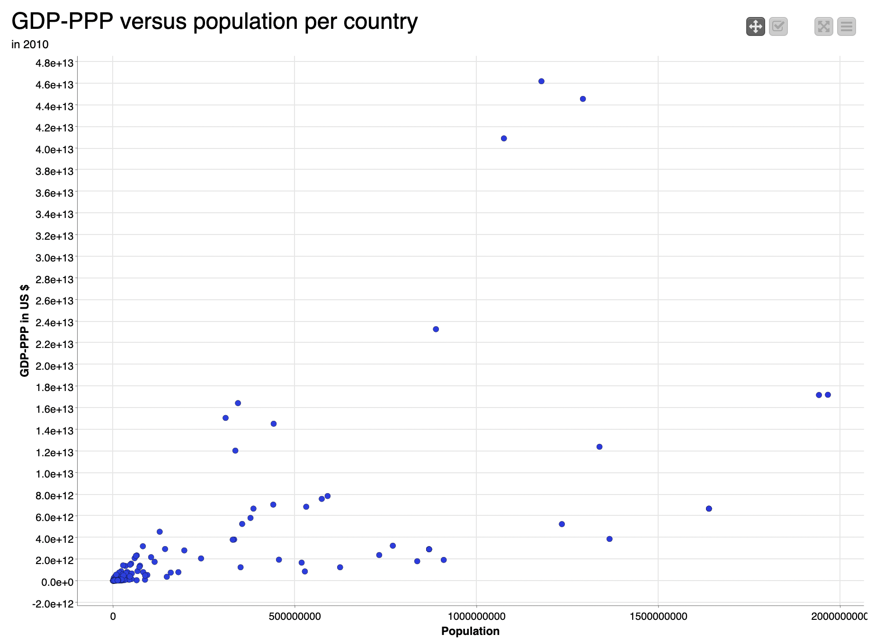
GDP-PPP vs. population growth

Slide 10
GDP-PPP vs. population growth
GDP ~ trippled
more countries with lower GDP growth

Slide 11
Conclusions
Investigation inconclusive: not enough variables (limitation of knime software)
Nuclear electricity production stable in years 1990-2010
Increase in oil, gas and coal electricity production in years 1990-2010
GDP-PPP roughly tripled between 1990-2010
Population growth not proportional to GDP-PPP growth (possibly even slower rate) indicating it was not the driving factor for more fossil fuel consumption

Slide 12
Q &A

